Slide 1
Accenture 1D: Content Moderation of Fake News
Presented By:
Lin, Kashvi, Nancy, Adriena, Ousman, Sanskriti and Harshika

Slide 2
Table of contents
01
02
03
Introduction/ Summary
Exploratory Data Analysis
Processing
04
05
06
Feature Engineering
Training Model: Logistic Regression
Training Model: BERT
Notes:
Edit this slide / create timeline

Slide 3


How can AI help us tell truth from lies online?
Real
VS
Fake
Treasury Secretary Mnuchin was sent gift-wrapped box of horse manure: reports
Pope Francis Just Called Out Donald Trump During His Christmas Speech
Notes:
Ask the audience which one is real or fake instead of stating. Give audience time to engage

Slide 4



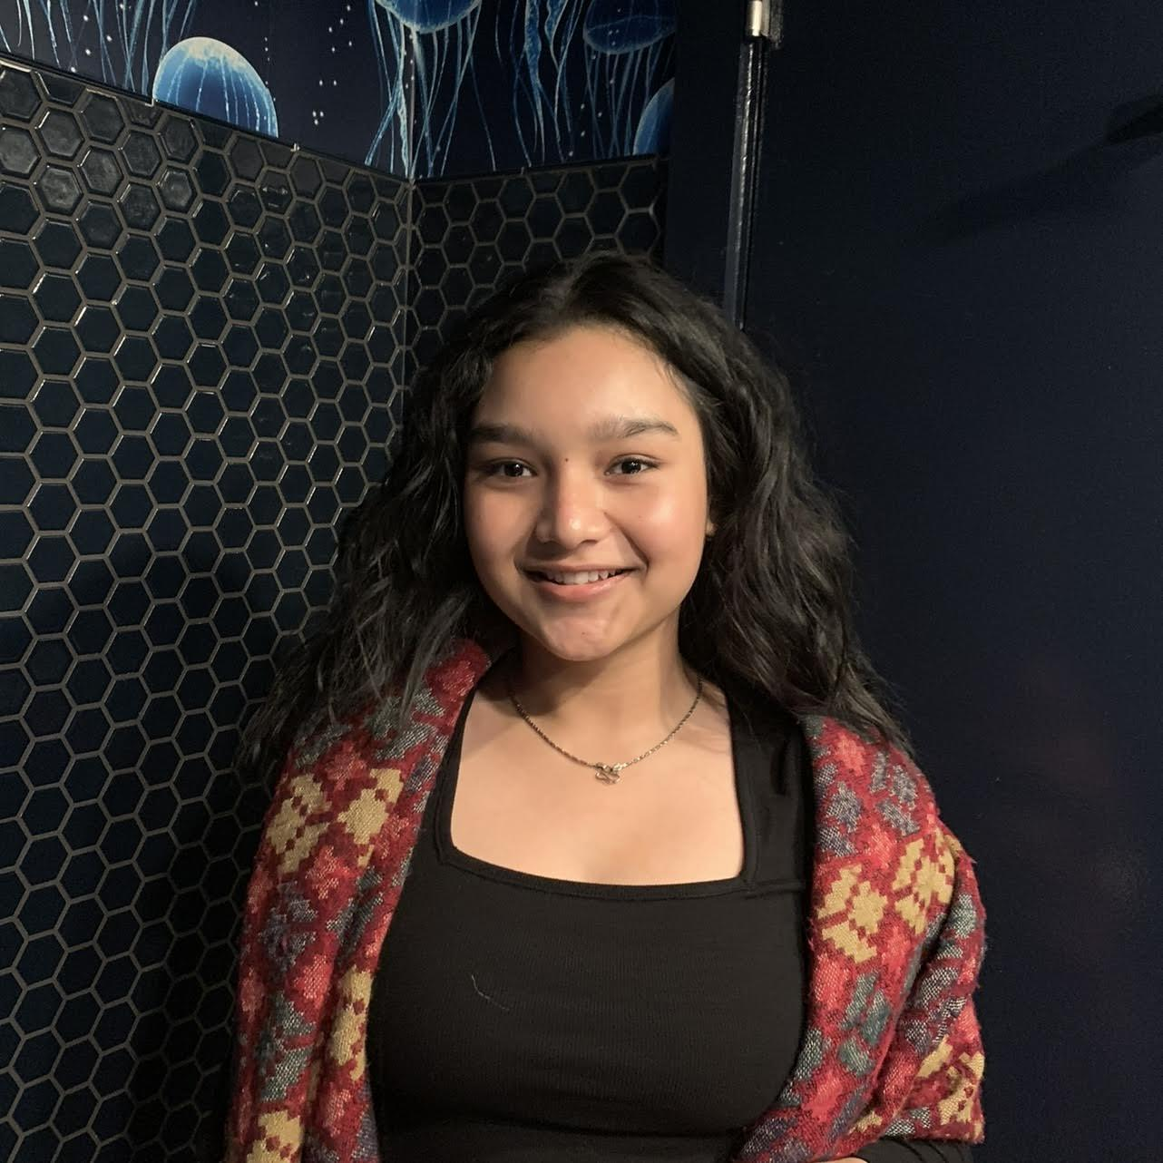



Our Team
Lin Zhang
Lipscomb University
Adriena Jiang
Stony Brook University
Ousman Bah
Florida International University
Sanskriti Khadka
City College of New York
Kashvi Vijay
UT Austin
Harshika Agrawal New Jersey Institute of Technology
Nancy Huang
Stony Brook University

Slide 5
Project Summary
What We Built:
Designed and trained a model combining: BERT (deep learning language model) and Logistic Regression
Analyzes both context and linguistic patterns of online articles, outputs Real or Fake classification
Why It Matters:
Supports safer, more trustworthy digital environments
Value for Accenture:
Directly aligns with Responsible AI initiatives
Strengthens Digital Trust offerings for clients
Automates content verification and risk detection
Notes:
Ex: 60% of news fake this is why we create this model

Slide 6
02
Exploratory Data Analysis
Notes:
56s

Slide 7
Exploratory Data Analysis
As a team we performed various exploratory data analysis techniques such as:
Word Lengths
Article Ending With ‘...’
Missing Values + Blank Text
Duplicate Entries
Unique Words
English Detection
Sentiment
Subject
Date Format
Source + URL
Author Bylines
Stop Words
Notes:
Our team performed various exploratory data analysis techniques such as the ones on the slide.
Use visuals, charts since bullet points are not visually appealing.

Slide 8
What did we find?
Fake news were slightly longer than true news!
Fake articles have a mean of 423.198 words per article and a median of 363 words per article.
Real articles have a mean of 385.640 words per article and a median of 359 words per article.
Fake dataset contained 630 blank articles. Real dataset contained 1 blank article.
None of the articles had missing values.
Fake news contained 10,671 duplicates and real news contained 427 duplicates!
Notes:
Fake news were slightly longer than true news. We found that fake articles have a mean of 423.198 and a median of 363 words per article and that real articles havea mean of 385.64 and a median of 359 words per minute. We also found that the fake data set contained 630 blank articles and the real dataset contained 1 blank article. We removed these blank articles as they do not have any real meaning. Additionally we found fake news contained 10,671 duplicates and real news contained 427 duplicates. We decided to remove these duplicates to clean our data set.

Slide 9
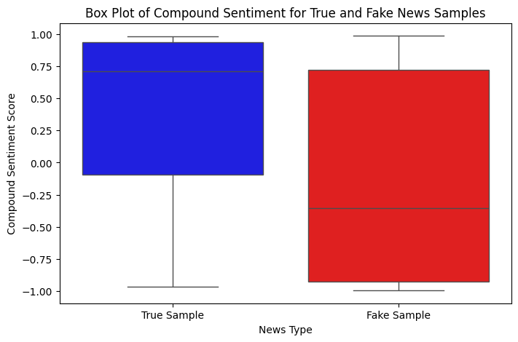
Sentiment Analysis
Finding: Fake articles were more negative while true articles leaned positive.
Fake articles median sentiment is approximately -0.4.
Real articles median sentiment is approximately 0.7.
Why? Fake articles tend to contain text that spoke poorly on someone/something. This is helpful in modeling as it can help differentiate fake news from true news. I.e., news with negative sentiment are more likely to be fake!
Decision! As a team we chose to keep these articles in our dataset.
Notes:
Give an example to why. I.e., our data set is mostly political so many of the fake news articles contained text that spoke poorly about presidents/government. This data could be helpful when training our model to correctly classify fake news.
Explain what sentiment is. Audience might not know what sentiment is.

Slide 10
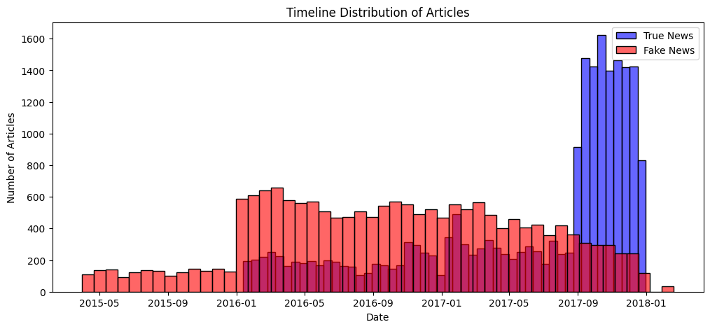
Date and Time Analysis
Finding: True articles were mostly from 2017.
Why? There is likely a spike in fake news in 2016 as that was the year of a presidential election. There is likely a spike in true news in 2017 as these elections are over!
Decision! We decided to split our dataset into testing and training sets based on these time periods.

Slide 11
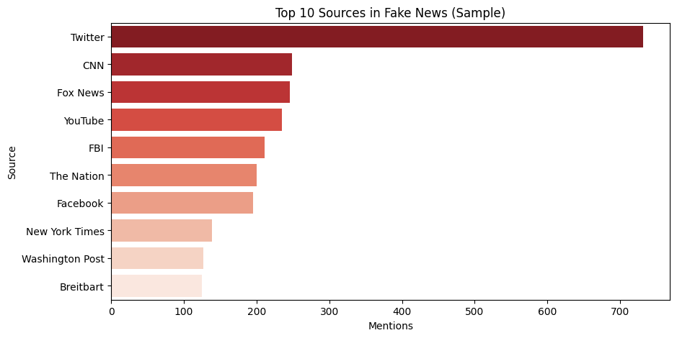
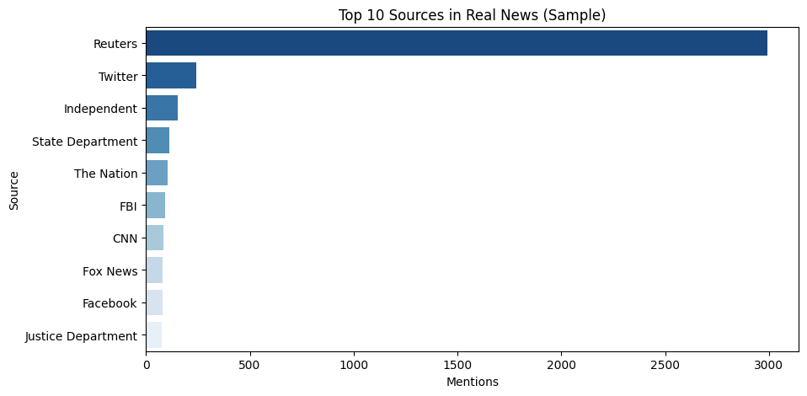
Source Analysis
Finding: True news were sourced mostly from Reuters. Fake news were sourced mostly from Twitter.
Fake articles had 732 articles from Twitter.
Real articles had 2994 articles from Reuters.
Decision! Our team decided to clean any mention of ‘Reuters’ from the real news dataset as none of the fake news articles were sourced from Reuters. We kept Twitter mentions.
Notes:
Reuters is a news agency company. Most true news were sourced from Reuters and fake news were mostly sourced from twitter.

Slide 12
03
Processing
Notes:
47s

Slide 13
What else did we do?
Subject Removal
URL Tokenization
Fake articles contained more URLs than the true articles dataset.
Tokenized URL so our model will not overfit and learn this pattern.
Stop Word Removal
Removed stop words so our models can learn base on the context of articles.
Removal of Non-English Text
Our model will be trained on purely english articles.
Date Standardization
Standardized our date column to be in the format MM/DD/YYYY for consistency.
Blank text Removal
Standardized our date column to be in the format MM/DD/YYYY for consistency.
Notes:
Stop words are extremely common words such as “the”, “is’, “and” and “in”. These words do not contain much meaning.
Not bullets, make more visually appealing.

Slide 14
What else did we do?
Subject Removal
URL Tokenization
Stop Word Removal
Removal of Non-English Text
Date Standardization
Blank text Removal
Notes:
Stop words are extremely common words such as “the”, “is’, “and” and “in”. These words do not contain much meaning.

Slide 15
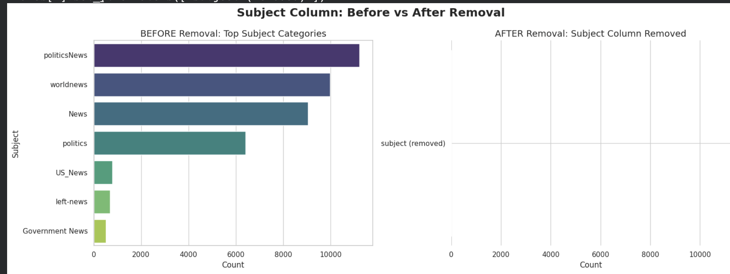
Subject Removal
WHY ?
To prevent bias & target leakage
Was not providing any meaningful data
Notes:
Stop words are extremely common words such as “the”, “is’, “and” and “in”. These words do not contain much meaning.

Slide 16
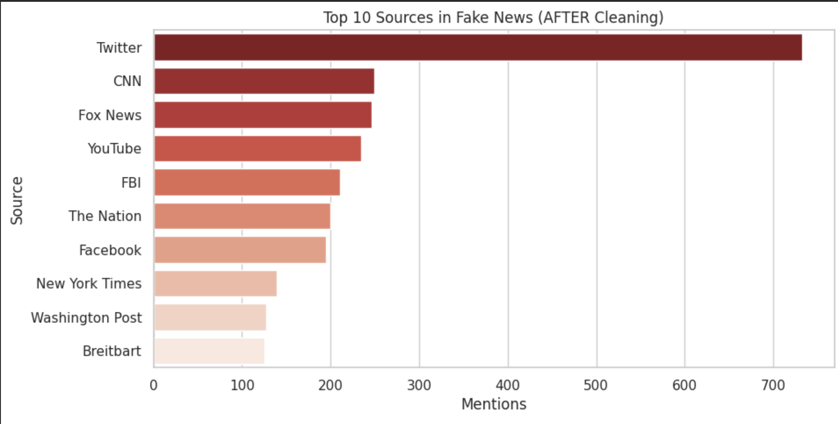
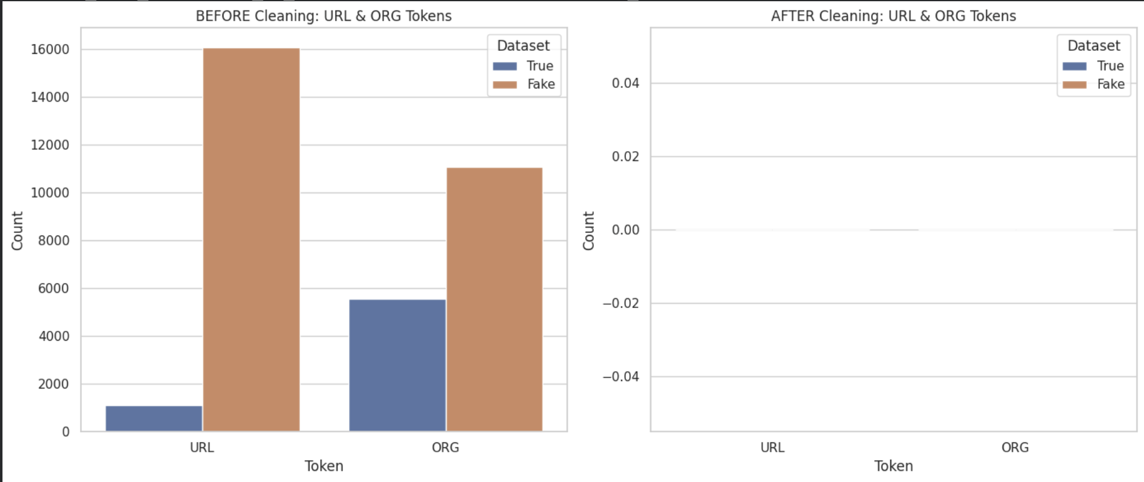
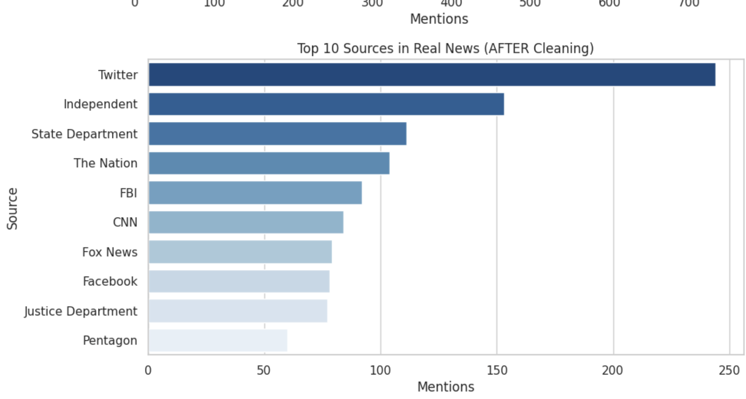
SOURCES REMOVAL + URL TOKENIZATION
Source distribution after subject removal
Fake News
URL Masking
Reuters Removal
All URLs were masked into a single <URL>token.
Reuters were removed to avoid overfitting.
URL Tokenization
True News
Notes:
Stop words are extremely common words such as “the”, “is’, “and” and “in”. These words do not contain much meaning.

Slide 17
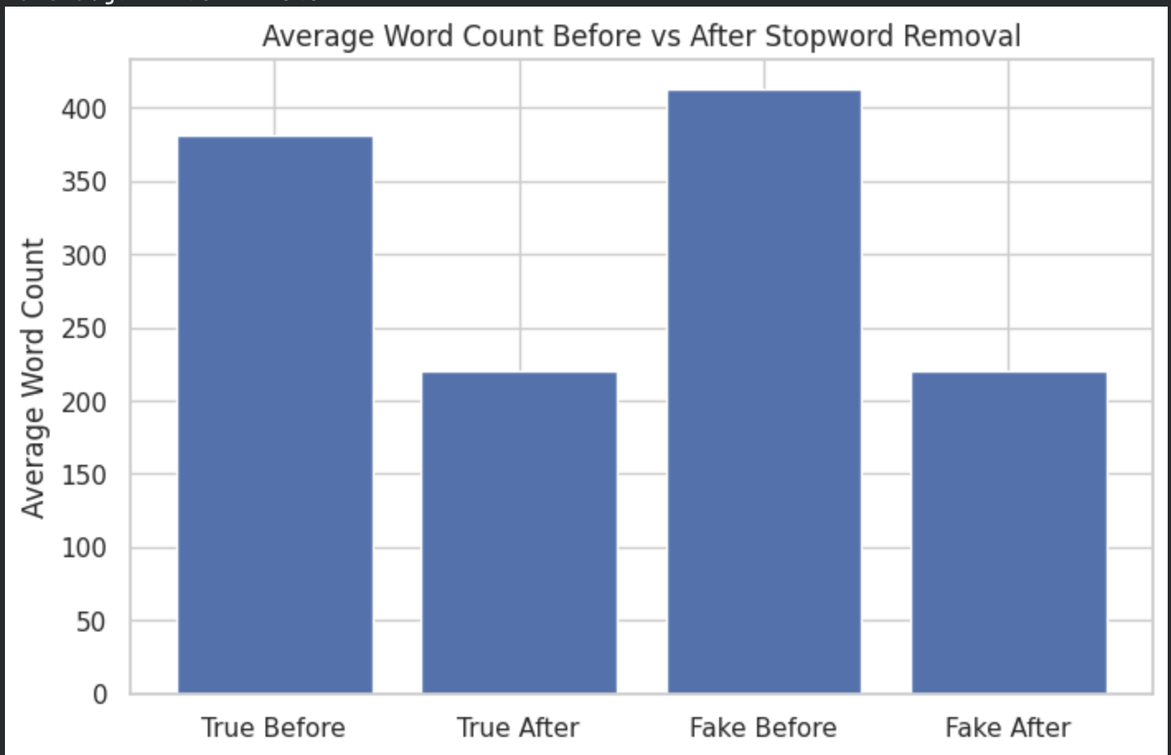
STOP WORD & NON ENGLISH WORDS REMOVAL
Non-English Text Filtering: Model was trained on English
Stop Word Removal:
True articles
Average length reduced from 380.7 words → 220.6 words
Fake articles
Average length reduced from 412.6 words → 219.9 words
After removing non-English articles, the fake-news dataset decreased from 17,442 to 17,086
Notes:
Stop words are extremely common words such as “the”, “is’, “and” and “in”. These words do not contain much meaning.

Slide 18
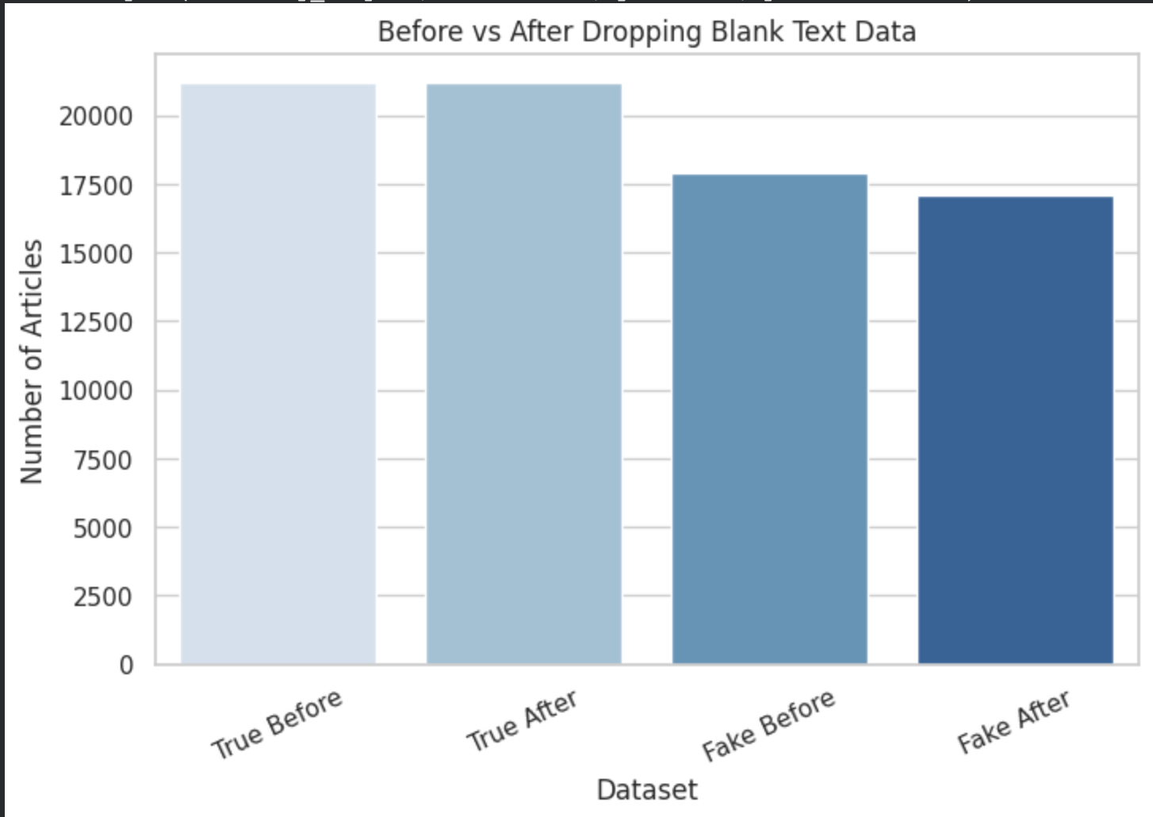
DATA STANDARDIZATION REMOVAL OF BLANK TEXT
Removal of Blank Text
True dataset: Went from 21,197 rows → 21,196 rows
Fake dataset: Went from 17,908 rows → 17,095 rows Removed: 813 blank entries
Date Standardization
All date fields were standardized into a consistent
MM-DD-YYYY format to ensure uniformity across.
Notes:
Stop words are extremely common words such as “the”, “is’, “and” and “in”. These words do not contain much meaning.

Slide 19
04
Feature Engineering
Notes:
57s

Slide 20
One-Hot Encoding
Purpose: Show the model each article’s text length in a numeric way.
Result: Added text_length_category_short, medium, long, which helps model see if article length relates to truthfulness.
Word & Character N-grams
Purpose: Capture common word phrases and writing styles.
Result: Added top unigrams, bigrams, trigrams, and 3–5 char n-gram features showing frequent language patterns.
SKIP

Slide 21
Sentiment Features
Purpose: Measure how positive, negative, or neutral the article sounds.
Result: Added vader_neg, vader_neu, vader_pos, vader_compound to reflect tone and emotion.
TF-IDF Vectorization
Purpose: Highlight important words and characters.
Result: Added combined word-level (1-2 grams) and character-level (3-5 grams) TF-IDF features for weighted text representation.
SKIP

Slide 22
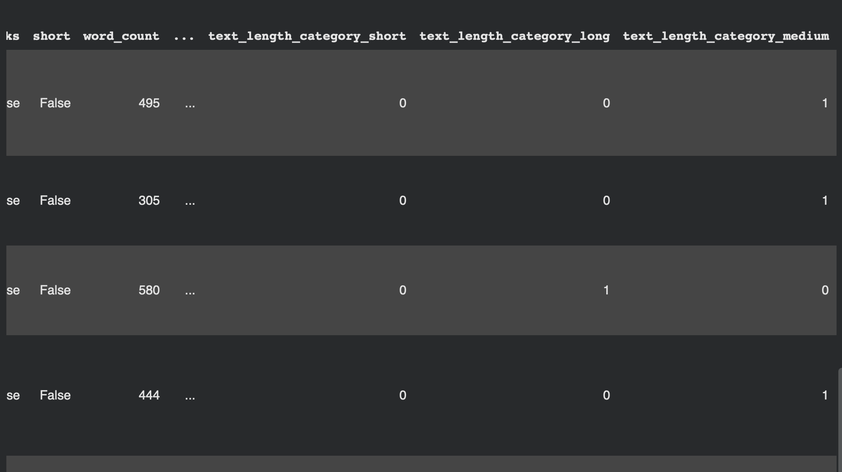
One-Hot Encoding
Show the model each article’s text length in a numeric way.
Added text length category short:
Short
Medium
Long
Notes:
Stop words are extremely common words such as “the”, “is’, “and” and “in”. These words do not contain much meaning.

Slide 23
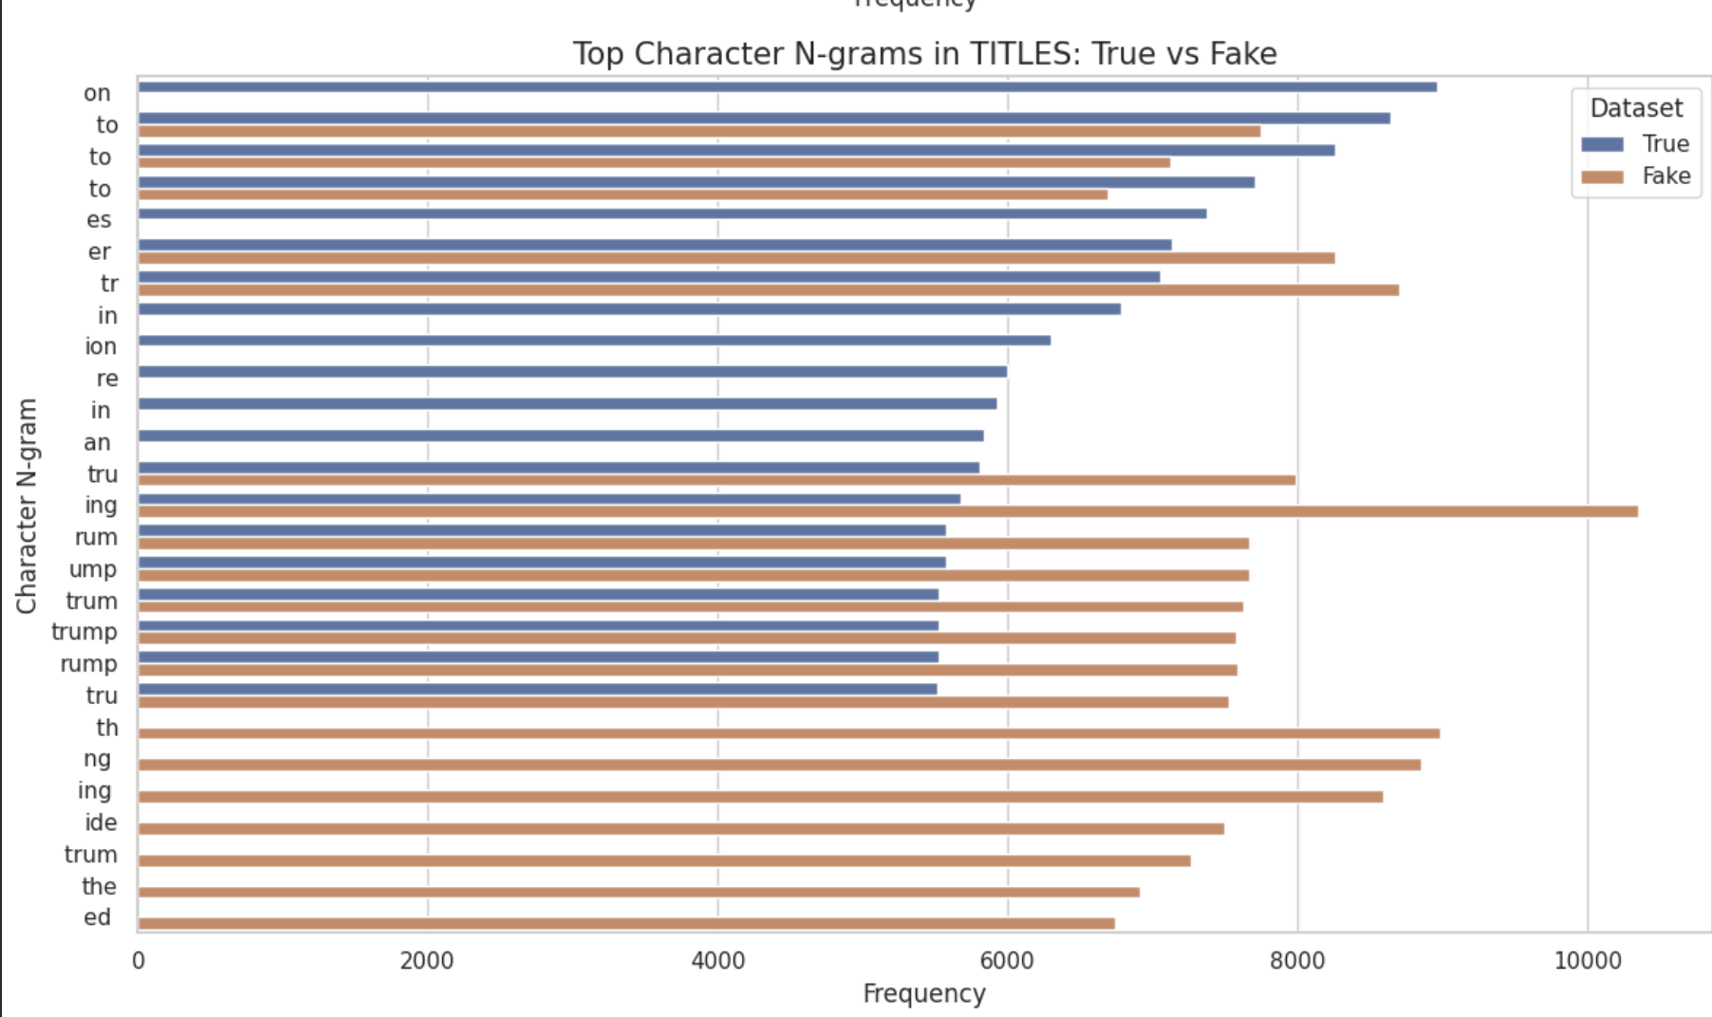
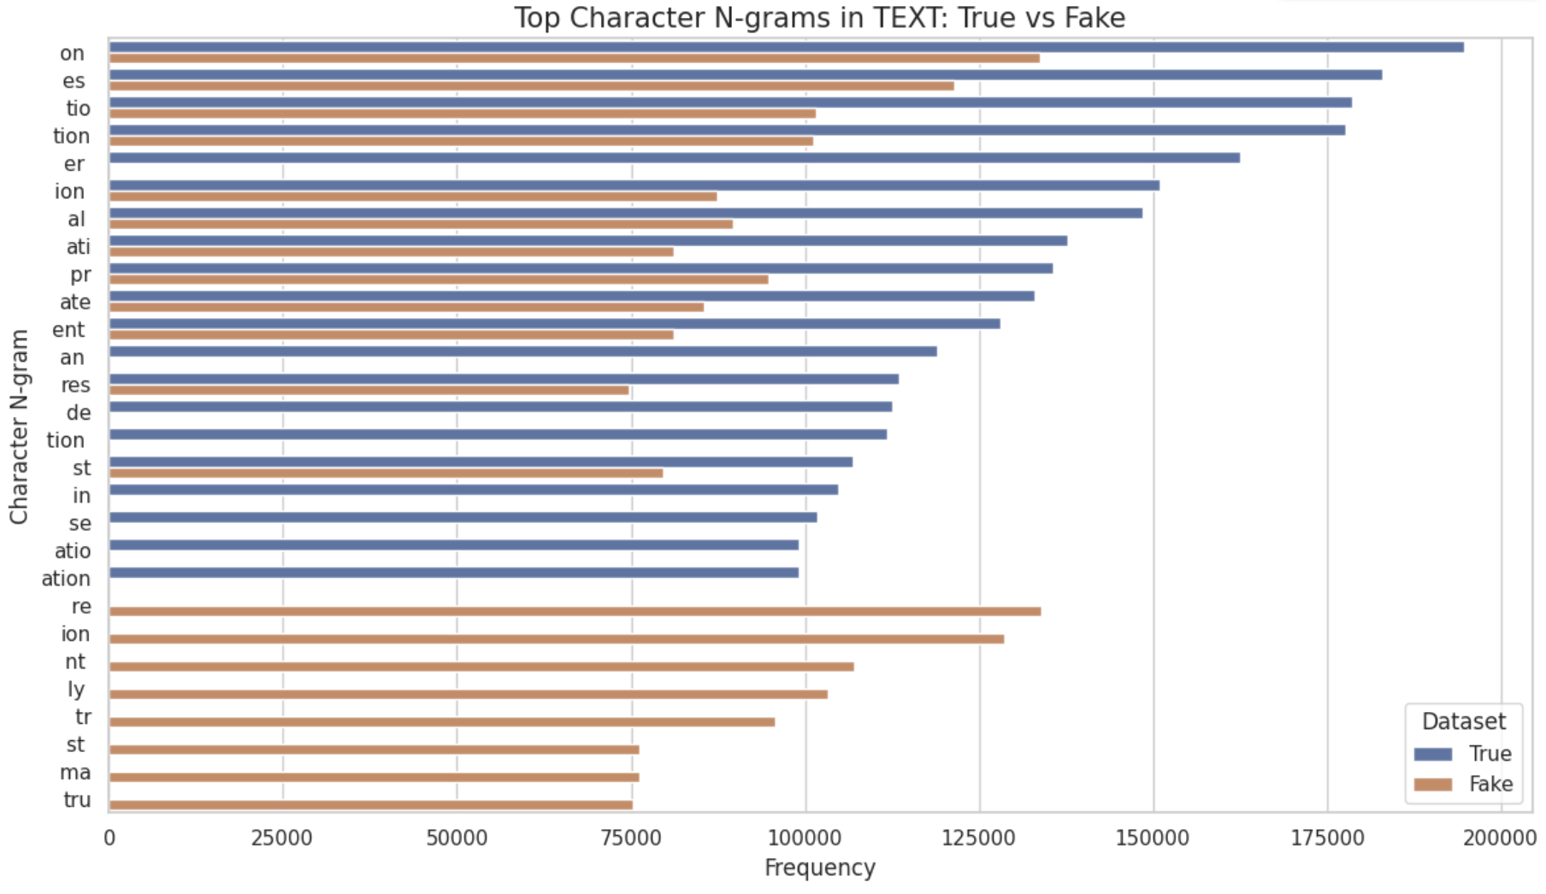
Word & Character N-grams
Title
Capture common word phrases and writing styles.
WHAT WE DID
Added top unigrams
Added bigrams & trigrams
Added 3–5 char n-gram features showing frequent language patterns.
Text
Notes:
Stop words are extremely common words such as “the”, “is’, “and” and “in”. These words do not contain much meaning.

Slide 24
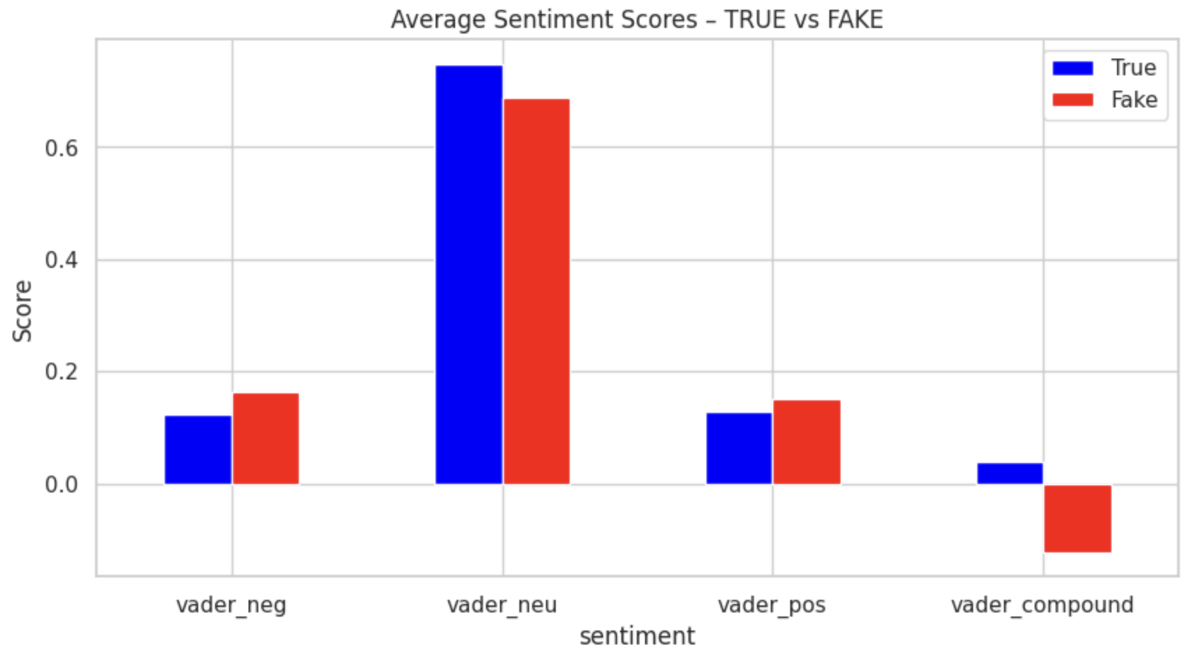
Sentiment Features
Created sentiment analysis
WHAT WE DID
Added top vader_neu: 0.0 → 1.0
Added vader_neg& vader_pos: 0 → 1 (typical: neg 0–0.3, pos 0–0.25)
Added vader_compound: –1.0 → +1.0
Notes:
Stop words are extremely common words such as “the”, “is’, “and” and “in”. These words do not contain much meaning.

Slide 25
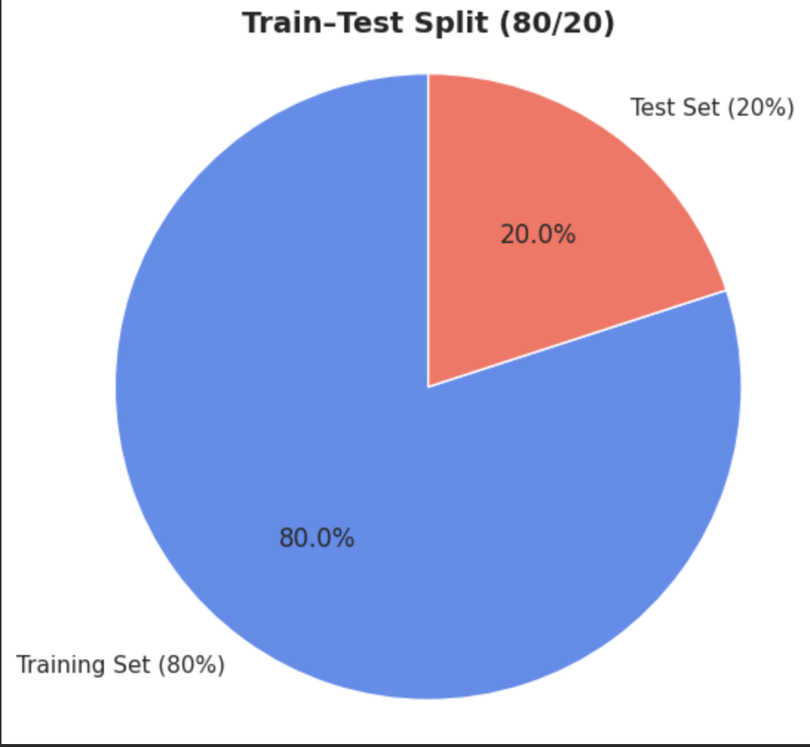
TRAIN TEST SPLIT
We split the dataset using 80/20 train–test split.
Stratified sampling to maintain balance.
Notes:
Stop words are extremely common words such as “the”, “is’, “and” and “in”. These words do not contain much meaning.

Slide 26
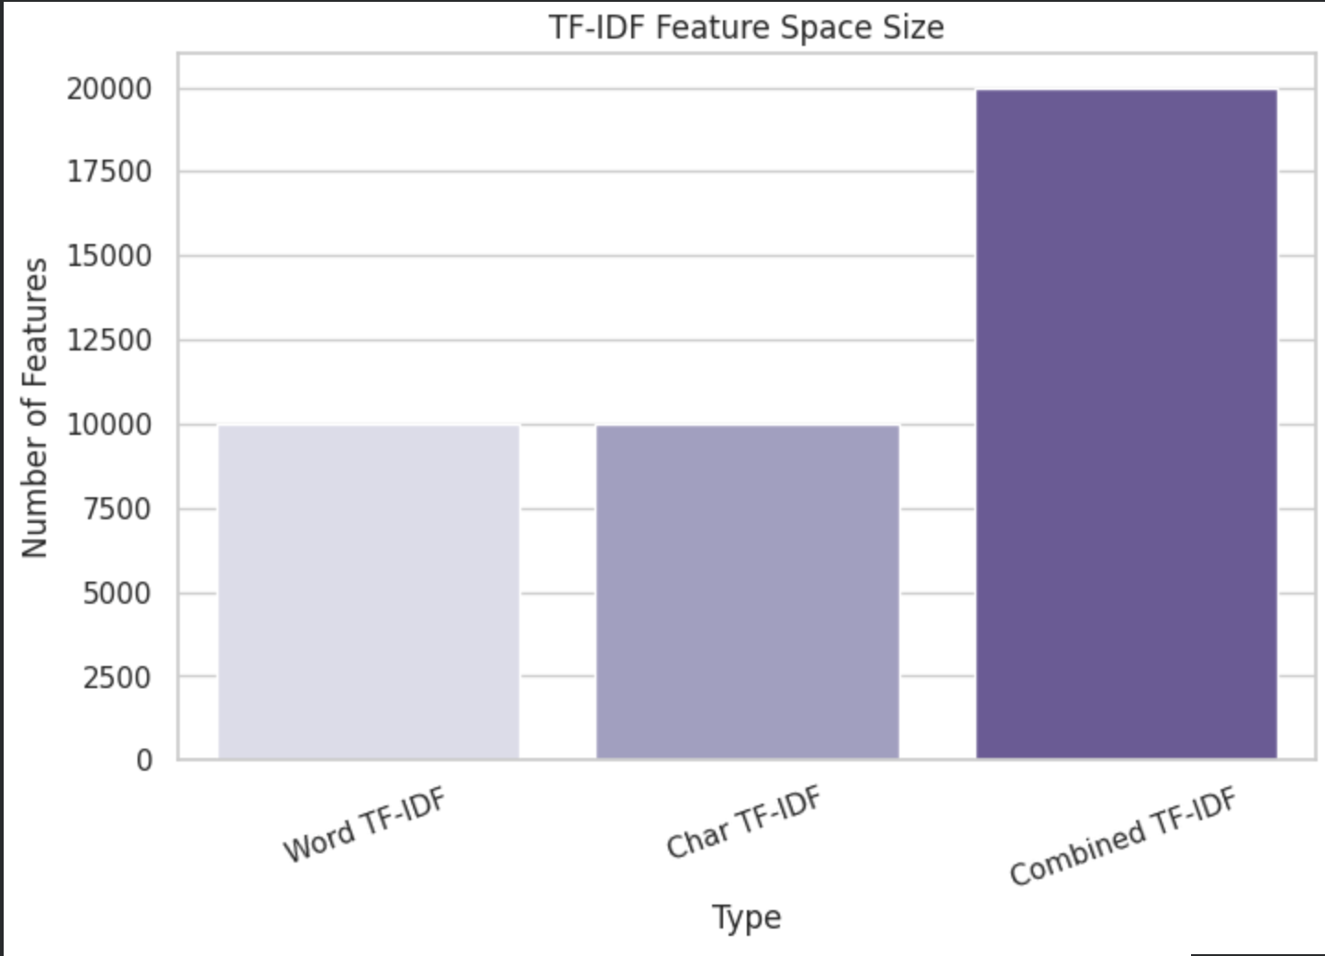
TF-IDF Vectorization
Highlight the most important words and character patterns by giving higher weight to terms that are more meaningful and less frequent across documents.
Word TF-IDF: Captures Content
Char TF-IDF: Captures style
Notes:
Stop words are extremely common words such as “the”, “is’, “and” and “in”. These words do not contain much meaning.

Slide 27
05
Model: Logistic Regression
Models used: Logistic Regression, BERT
Notes:
1:30

Slide 28
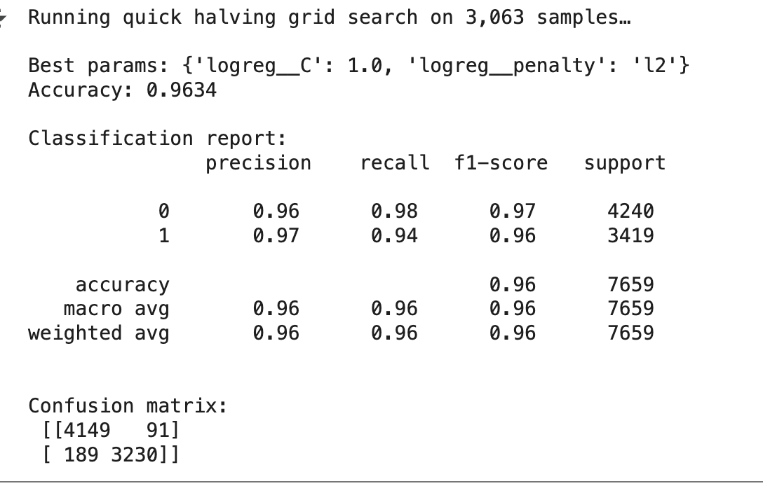
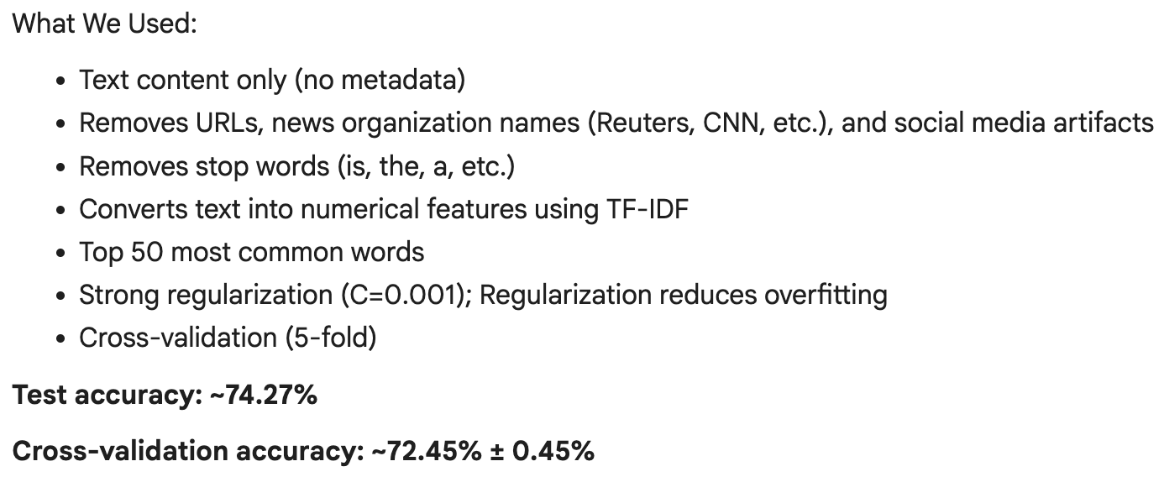
Logistic Regression
Goal: Detecting misleading/fabricated news articles with high accuracy and trust using Logistic Regression with a TF-IDF Pipeline
Logistic Regression is lightweight and easy to interpret.
Effective with TF-IDF: Captures key linguistic and stylistic cues of misinformation.
Optimal Parameters for Logistic Regression & Result Analysis
After running HalvingGridSearchCV, the best parameters was a C value of 1, and an L2 penalty
Accuracy = .96, F1-score: 0 (true): 0.97 and 1 (false): 0.96
Signs of Overfitting with High Accuracy and L2 Penalty: need to revisit feature engineering to check for data leakage
2nd run (removed article names, stop words) → 74% accuracy

Slide 29
06
Model: BERT
Bidirectional Encoder Representation from Transformers, developed by Google
Notes:
1:22

Slide 30
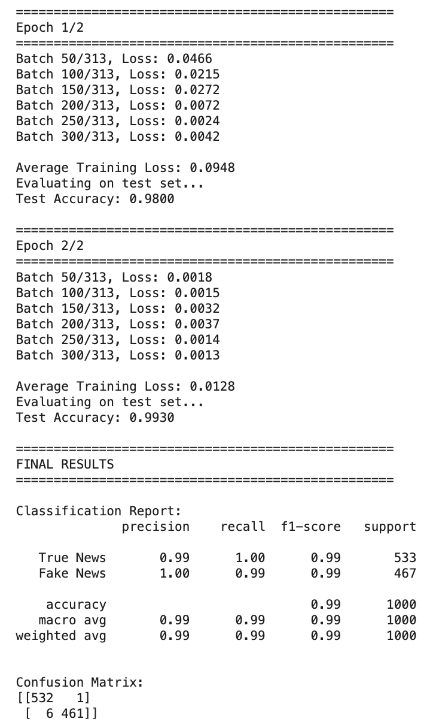
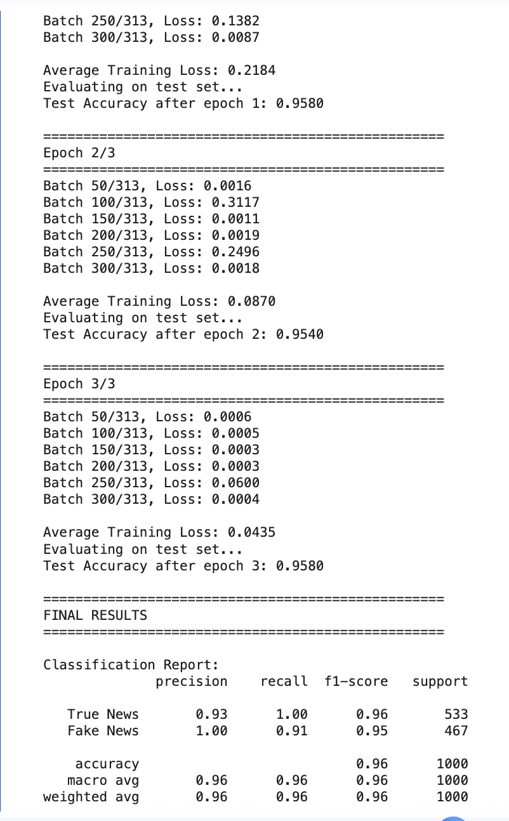
The BERT Model
(Bi-Directional Encoder Representations from Transformers)
Why?
Understands meaning and performs better on nuanced & long-form text
Our tests
First training run (5k sample)
99% Accuracy → Data Leakage
Re-visit data cleaning: URLs, duplicate articles, subject, etc
Second training run (5k sample)
95% Accuracy: Improvement!
Lower fake news recall (91%) shows the model is now relying on actual content, not shortcuts
→
Notes:
And diving into a more nuanced approach, we choose to use BERT because it reads text bidirectionally meaning it captures both factual tone and any misleading cues. So, after we finished cleaning our data and preprocessed it, the results we got back really showed us how important high quality inputted data is to make a model successful. Which was not what we accomplished
Because when we trained BERT using a sample of 5k articles and in the first round of training, we saw a 98% accuracy rate which is way too high so this raises suspicions for us. So, we’re aware that this reflected a data leakage. To combat this issue, we decided to look back into our data cleaning and feature engineering. We discussed, dropping the subject column, not removing stop words for BERT because it might hurt the model rather than help it, and we considered removing location
But on the brighter note, when the model was training the second round of it showed a 99% accuracy rate which shows the model improving so hopefully after we fixed some data leakage, we can have a better evaluation of how our model is actually doing.
IGNORE IGNORE IGNORE IGNORE IGNORE IGNORE IGNORE IGNORE IGNORE
BERT reads text bidirectionally, meaning it captures both factual tone and misleading cues (ideal for nuance articles to be trained by)
we should drop the subject column (I remember we decided to reinstate this but there is a lot of political news which makes it easy for the model to catch up on the fake/true news)
removing stop words consideration, after doing some research it seems like removing stop words is hurting the BERT model's training so we should consider cloning and having a seperate dataframe dedicated to BERT (or use the one where stop words aren't removed) : text_for_bert
thoughts on removing: location/social media handles
ngrams showed that the fake news articles also had image urls and some videos which does not help us in any way so thoughts on removing them?
Introduction:
Our goal in this project is to build a model capable of detecting misleading/fabricated articles with high accuracy and trust. We chose BERT because of its ability to read text bidirectionally. This allows it to capture subtle information patterns and emotional tones which is crucial for recognizing both blatant and nuance fake news. Unlike other traditional methods that only focuses on word frequency (TF-IDF), BERT understands the context and sentiment behind the words
Why BERT:
We chose BERT because it can better understand context rather than simply focusing on keywords. This is essential for fake news detection, where the same words in different contexts can mean something entirely different. BERT helps us distinguish subtle misinformation cues in long-form text, which is much harder for simpler models to capture.
Our Model:
We're using the bert-base-uncased model pre-trained by Google. We started by training on only 5,000 samples to speed up development. In the first round of training, we saw 98% accuracy. However, we’re aware that this might reflect data leakage, especially after seeing high accuracy early on. We’re actively addressing this by refining the dataset and re-training with more balanced data.
Our experience:
After we cleaned and preprocessed our data, we saw that BERT’s success is highly dependent on high quality input.
Example: We masked URLs because fake news often contained external links, which could have led to data leakage if it remained unmasked. Since, fake news articles in our dataset were often recognized simply because they contain URLs, this is not a pattern that we want BERT to learn. So, instead of masking we decided to remove them entirely so the model can focus more on the sentiment and meaning behind the text.
We're using the bert-base-uncased model pre-trained by Google. After we cleaned and preprocessed our data, we saw that BERT’s success is highly dependent on high quality input because we realized we needed to re-visit cleaning data and our feature engineering. Because in the first round of training, we saw 99% accuracy which suggests overfitting and data leakage. We decided to tackle this problem by
We’re actively addressing this by refining the dataset and re-training with more balanced data.

Slide 31
07
Model: Neural Networks
Notes:
1:22

Slide 32
Goal: Deep Learning Approach to Fake News Detection
Leveraging TensorFlow/Keras to capture complex linguistic patterns through neural architectures
Model A - Global Average Pooling
Uses word embeddings + averaging
Learns the overall meaning of the article
Simple and fast baseline
Model B - 1D CNN
Uses embeddings + a convolution layer
Learns patterns in phrases (n-grams)
Better at detecting tone and structure
Results & Analysis:
AVG Embedding Model: 93.5% Accuracy CNN Model: 96.0% Accuracy
Suspicion of Overfitting: High accuracies may indicate potential data leakage or overfitting.
Notes:
And diving into a more nuanced approach, we choose to use BERT because it reads text bidirectionally meaning it captures both factual tone and any misleading cues. So, after we finished cleaning our data and preprocessed it, the results we got back really showed us how important high quality inputted data is to make a model successful. Which was not what we accomplished
Because when we trained BERT using a sample of 5k articles and in the first round of training, we saw a 98% accuracy rate which is way too high so this raises suspicions for us. So, we’re aware that this reflected a data leakage. To combat this issue, we decided to look back into our data cleaning and feature engineering. We discussed, dropping the subject column, not removing stop words for BERT because it might hurt the model rather than help it, and we considered removing location
But on the brighter note, when the model was training the second round of it showed a 99% accuracy rate which shows the model improving so hopefully after we fixed some data leakage, we can have a better evaluation of how our model is actually doing.
IGNORE IGNORE IGNORE IGNORE IGNORE IGNORE IGNORE IGNORE IGNORE
BERT reads text bidirectionally, meaning it captures both factual tone and misleading cues (ideal for nuance articles to be trained by)
we should drop the subject column (I remember we decided to reinstate this but there is a lot of political news which makes it easy for the model to catch up on the fake/true news)
removing stop words consideration, after doing some research it seems like removing stop words is hurting the BERT model's training so we should consider cloning and having a seperate dataframe dedicated to BERT (or use the one where stop words aren't removed) : text_for_bert
thoughts on removing: location/social media handles
ngrams showed that the fake news articles also had image urls and some videos which does not help us in any way so thoughts on removing them?
Introduction:
Our goal in this project is to build a model capable of detecting misleading/fabricated articles with high accuracy and trust. We chose BERT because of its ability to read text bidirectionally. This allows it to capture subtle information patterns and emotional tones which is crucial for recognizing both blatant and nuance fake news. Unlike other traditional methods that only focuses on word frequency (TF-IDF), BERT understands the context and sentiment behind the words
Why BERT:
We chose BERT because it can better understand context rather than simply focusing on keywords. This is essential for fake news detection, where the same words in different contexts can mean something entirely different. BERT helps us distinguish subtle misinformation cues in long-form text, which is much harder for simpler models to capture.
Our Model:
We're using the bert-base-uncased model pre-trained by Google. We started by training on only 5,000 samples to speed up development. In the first round of training, we saw 98% accuracy. However, we’re aware that this might reflect data leakage, especially after seeing high accuracy early on. We’re actively addressing this by refining the dataset and re-training with more balanced data.
Our experience:
After we cleaned and preprocessed our data, we saw that BERT’s success is highly dependent on high quality input.
Example: We masked URLs because fake news often contained external links, which could have led to data leakage if it remained unmasked. Since, fake news articles in our dataset were often recognized simply because they contain URLs, this is not a pattern that we want BERT to learn. So, instead of masking we decided to remove them entirely so the model can focus more on the sentiment and meaning behind the text.
We're using the bert-base-uncased model pre-trained by Google. After we cleaned and preprocessed our data, we saw that BERT’s success is highly dependent on high quality input because we realized we needed to re-visit cleaning data and our feature engineering. Because in the first round of training, we saw 99% accuracy which suggests overfitting and data leakage. We decided to tackle this problem by
We’re actively addressing this by refining the dataset and re-training with more balanced data.

Slide 33
08
Conclusion
Notes:
2:10

Slide 34
Summary of the model
Data Cleaning
Cleaned 45k articles → Dropped 10k duplicates and 2.7% noise
Feature Engineering
TF-IDF (word/char n-grams) → 20k sparse features
VADER sentiment analysis
Model Training
Logistic regression → 96% accuracy
fine-tuned BERT model → 99% accuracy
Plots
20+ publication-grade plots (box, histograms, bar charts)
Notes:
Our team was able to learn and gain skills in various parts of machine learning by building this project
Let’s walk-through what we learned
- data cleaning --> we started with 45k articles and were able to eliminated over 10,000 duplicates, removed blank and ultra-short entries, and standardized formatting
- Feature-wise, we engineered NLP features → TF-IDF vectors on both word and character n-grams – converting raw data words into 20k dimensions , BERT tokenizers, added sentiment score using VADER and achieved high accuracy tuning
- In deep learning, we fine-tuned BERT and built 1D CNNs in Keras
Finally visualisation, we produced 20+ publication-quality plots — boxplots of sentence length, histograms of special characters, and confusion matrices showing precision of our model
And documentation, we learned how to document our work for our team to understand effectively

Slide 35
Observations, Next Steps and future directions for the project
Issues and Improvement
Initial 99% accuracy
Perform overfitting test
Potential data leakage (train/test overlap)
Re-train models → target 70-75% accuracy
Deployment
Build web application
Real-time analysis
Confidence score and evidence highlight
This model is mainly for political news
Notes:
We found that this model is specifically for political news
Problems
Improvements
Our model has achieved 99% accuracy but we hope to re-train the model to make it lower and bring it down to 70%
by re-training and fine-tuning both logistic and BERT model
We want to eliminate data leakage.
Future
And we want to create a web application to deploy our model to provide real-time data analysis by displaying confidence score and highlighted evidence

Slide 36
Acknowledgments
EDA & QUALITY
Harshika, Ousman, Lin, Sanskriti
FEATURES
Nancy, Kashvi, Adriena
MODELS
Kashvi (LogReg), Nancy/Lin/Adriena (BERT), Sanskriti/Ousman (CNN)
VISUALIZATION
Adriena
Coach and Challenge Advisor
Jenna and Abdul
Notes:
In the end, none of this would have be possible without my team, ADRIENA LIN NANCY KASHVI and SANSKRITI
- and our coach JENNA
- Thank you. Any questions

Slide 37
Thank you!

